Slide 1

Adaptive Exam & Skill-Based Course Recommendation System
MAHIMA K JOHNY
Reg. No. MGP21NMC043
S10 IMCA, Department of Computer Applications,
Saintgits College of Engineering (Autonomous), Pathamuttom -686532
Under the Guidance of
Ms. VIDYA N
ASSISTANT PROFESSOR
Department of Computer Applications,
Saintgits College of Engineering (Autonomous), Pathamuttom -686532

Slide 2
CONTENTS
1
Introduction
3
4
Target Audience
2
5
6
7
8
Technologies used
Database Details
System Architecture
Development Process
9
10
Features and Functionalities
Technical Challenges
Existing Applications
Objective
11
Testing Methods
12
Future Enhancements
13
Conclusion

Slide 3
INTRODUCTION
The Adaptive Exam & Skill-Based Course Recommendation System is a web-based learning platform built using the MERN Stack. It provides personalized exams and learning support by adjusting question difficulty based on student performance.
The system allows students to take adaptive exams, view performance analytics, and receive study material recommendations like PDFs, videos, and courses. An interactive chatbot suggests skill-based courses based on student interests and learning goals.
The platform integrates data cleaning, analytics, visualization, and AI-assisted insights into a single system, enabling faster and more efficient decision-making.

Slide 4
EXISTING SYSTEM
Exams are static — all students receive the same set of questions, regardless of their skill level.
Question difficulty does not adapt based on student performance during the test.
Study materials and course recommendations are general, not personalized.
Students receive only final scores, without detailed performance analysis.
No intelligent chatbot or interactive guidance system to help students choose learning paths.

Slide 5
OBJECTIVE
The main objectives of the project are:
To develop an adaptive examination system that adjusts question difficulty based on student performance.
To provide interactive dashboards for data visualization
To suggest skill-based courses aligned with student interests and learning needs.
To integrate an interactive chatbot that guides students in choosing suitable learning paths.

Slide 6
TARGET AUDIENCE
The application is designed for learners and educational organizations who need a smart and personalized learning platform. Target users include:
Students preparing for exams and aiming to improve their skills.
Teachers who manage exams, assignments, and monitor student progress.
Educational institutions implementing digital learning systems.
Training centers offering skill development programs
The system helps users take adaptive exams, analyze performance easily, and receive personalized study materials and course suggestions without needing advanced technical knowledge.

Slide 7
TECHNOLOGIES USED
Frontend —HTML, CSS, JavaScript, React.js
Used to design user interface and dashboards
Provides responsive and interactive user experience
Backend — Node.js & Express.js
Handles server-side logic and APIs
Manages exam processing and user requests
Database — MongoDB
Stores user data, exam records, and question bank
Provides flexible and scalable data storage
Authentication & Security — JWT & Role-Based Access
Ensures secure login and user authentication
Controls access based on user roles

Slide 8
TECHNOLOGIES USED
Data Visualization — Chart.jsEnables
Generates performance analytics through interactive charts and graphs
Helps students understand topic-wise strengths and weaknesses
Tools & IDE — Visual Studio Code
Used for application development and debugging
Supports extensions for JavaScript, Node.js, React, and MongoDB
Version Control — Git & GitHub
Git tracks code changes during development
GitHub stores the project repository and enables collaboration

Slide 9
DATABASE DETAILS
The system uses a NoSQL database to manage users, exams, and learning resources. Main database collections include:
Admins Collection: Stores admin login and management details.
Students Collection: Stores student profiles and login information.
Teachers Collection: Stores teacher profiles and subject details.
Questions Collection: Stores exam questions, options, answers, and difficulty levels.
ExamSessions Collection: Stores student exam attempts, responses, and scores.
Courses Collection: Stores course details and skill levels.
Materials Collection: Stores study materials like PDFs and videos.
This database structure ensures efficient storage, quick data retrieval, and smooth management of exams and learning resources..

Slide 10
SYSTEM ARCHITECTURE
User interacts with the system through a web browser
Frontend handles UI and visualization
The backend processes exam logic, performance analysis, and course recommendation rules.
The database stores user data, questions, exam results, courses, and learning materials.
The chatbot system provides interactive guidance and personalized course suggestions.

Slide 11
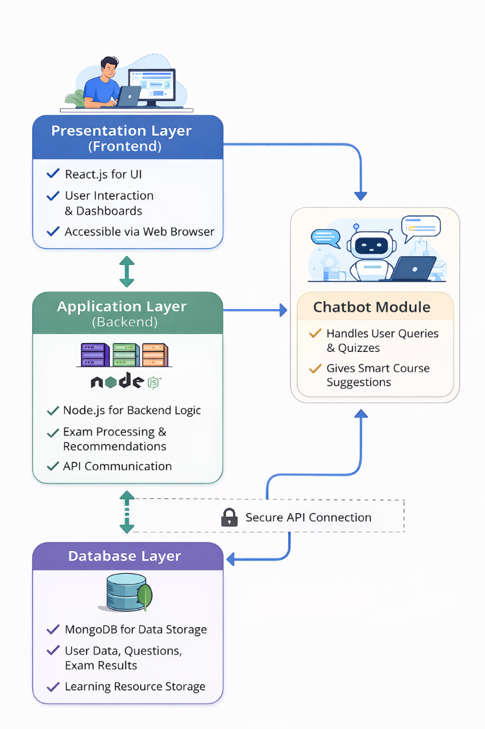

Slide 12
MODULES OF THE SYSTEM
Admin Module
Instructor Module
Student Module
AI Chatbot Module
Database Management Module

Slide 13
DEVELOPMENT PROCESS
The system was developed using a modular and iterative development process. Key development stages include:
• Requirement analysis and system design • Study of existing online exam and learning platforms • Database design and architecture planning • Implementation of authentication and user management modules • Development of adaptive exam and question management system • Implementation of performance analysis and scoring modules • Development of dashboard and data visualization components • Integration of rule-based chatbot and course recommendation system • Testing and Deployment

Slide 14
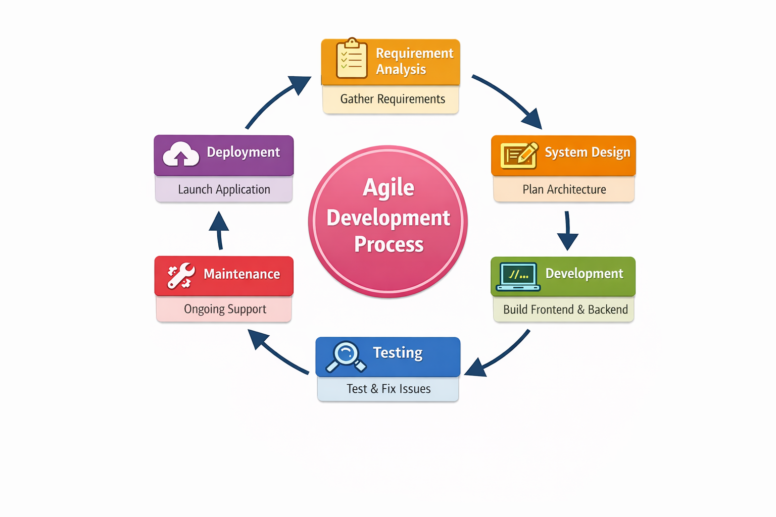

Slide 15
FEATURES AND FUNCTIONALITIES
1. User Registration and Login
Users can create an account using email and password. Registered users can log in securely to access the platform. Authentication ensures secure access to exams and learning resources.
2. Adaptive Online Examination
Students can take online exams through an interactive interface. Question difficulty adjusts based on student performance. Provides a personalized assessment experience.
3. Performance Analysis
Students can view exam scores and detailed results. Topic-wise analysis helps identify strengths and weak areas. Helps learners focus on areas that need improvement.

Slide 16
4. Course Recommendation System
System suggests courses based on student performance. Recommendations are provided according to skill level andinterests. Helps students choose suitable learning paths.
5. Study Materials Access
Students can access learning materials like PDFs and videos. Materials are organized based on subjects and topics. Supports better exam preparation and concept understanding.
6. Chatbot Assistance
Interactive chatbot guides students through learning options. Provides course suggestions based on quiz performance. Helps users with quick support and guidance.

Slide 17
7. Instructor Management
Teachers can add and manage question banks.Can monitor student performance and exam results.Helps in effective academic evaluation.
8. Admin Dashboard
Admin can manage students, teachers, and courses.Monitors system usage and overall performance.Ensures smooth platform management.

Slide 18
TECHNICAL CHALLENGES
1. Implementing Adaptive Exam Logic
Challenge:Designing an exam system where question difficulty changes based on student performance was complex to implement and manage.
Solution:This was solved by creating rule-based logic that adjusts question levels according to previous answers and scores.

Slide 19
2. Connecting Frontend and Backend
Challenge:Another challenge was connecting the React frontend with the Node.js backend APIs and ensuring that data such as user details, exam questions, answers, and results were sent and received correctly between the client (browser) and the server.
Solution:This was solved by creating proper REST APIs using Express.js and testing them to ensure smooth data communication between the frontend interface and backend server.

Slide 20
TESTING METHODS
1. Unit Testing
Each module such as authentication, exam logic, and chatbot was tested individually.Ensured every component functioned correctly on its own.
2. Integration Testing
Tested the interaction between frontend, backend, and database modules.Ensured smooth data flow and proper communication across the system.
3. Functional Testing
Tested major features like user login, taking exams, viewing results, and course recommendations.Ensured the system worked according to user requirements.

Slide 21
FUTURE ENHANCEMENTS
Add voice-based chatbot assistance for better user interaction.
Integrate live online classes and virtual mentoring features.
Add gamification features like badges and leaderboards to improve student engagement.
Implement advanced AI algorithms for more accurate and intelligent course recommendations.

Slide 22
CONCLUSION
The system provides a personalized and adaptive learning environment for students.
Adaptive exams help in accurately evaluating student knowledge and skills.
Performance analysis enables students to identify strengths and weak areas.
Course recommendations and study materials support targeted skill improvement.
The platform offers a modern and efficient solution for digital education

Slide 23
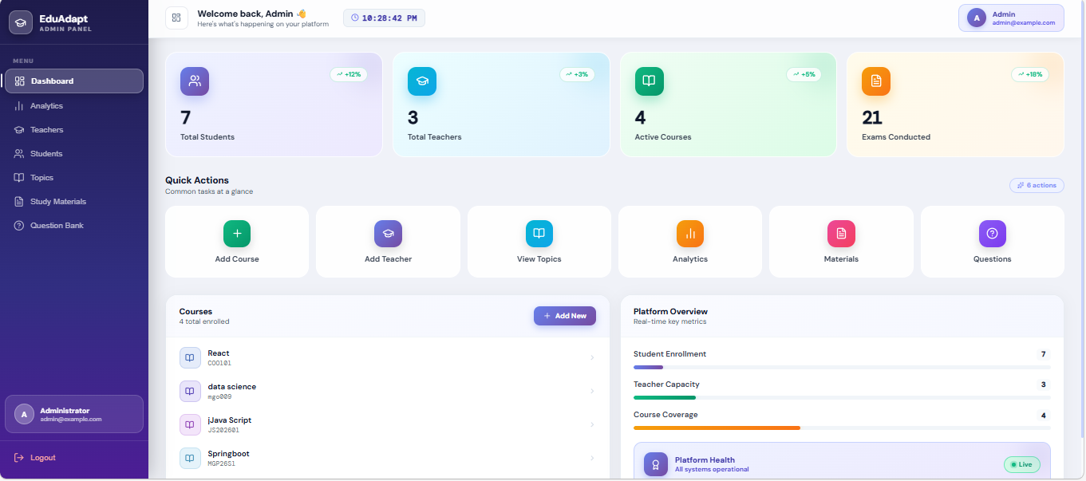
DEMO

Slide 24
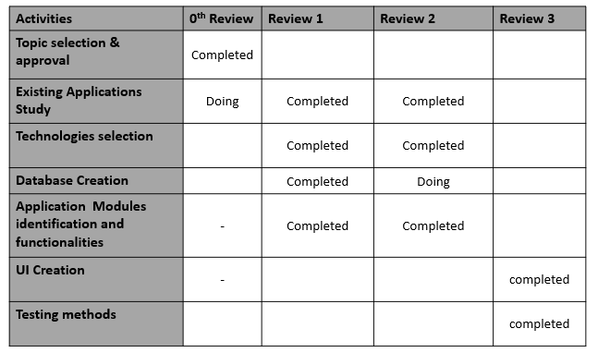
Present Status of the Project

Slide 25
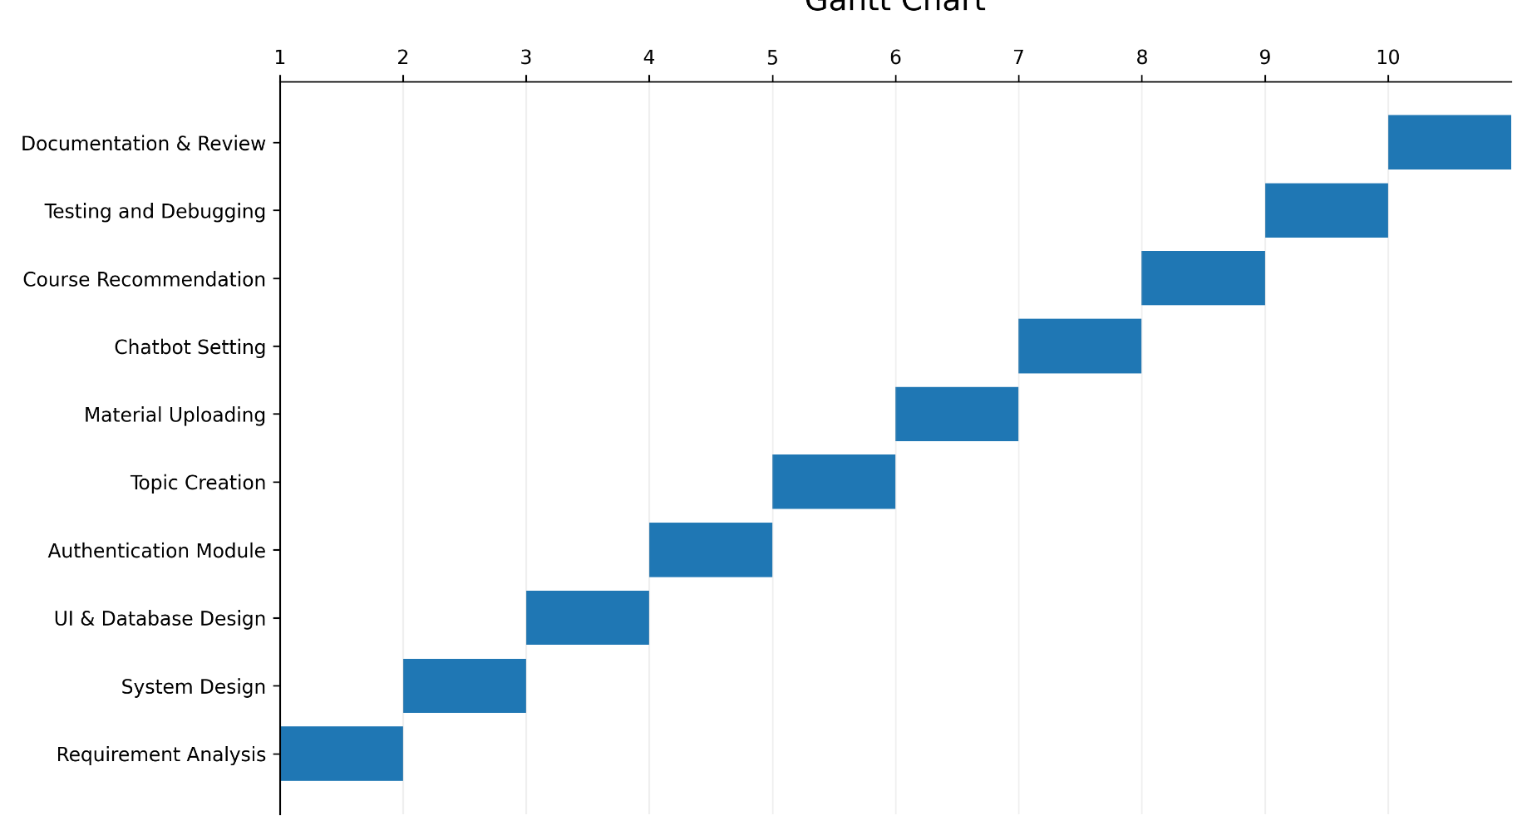
GANTT CHART

Slide 26
THANK YOU

